Slide 1
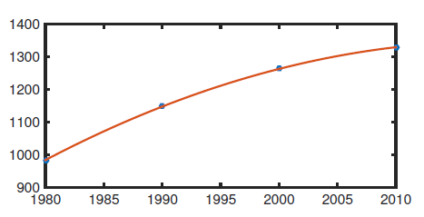
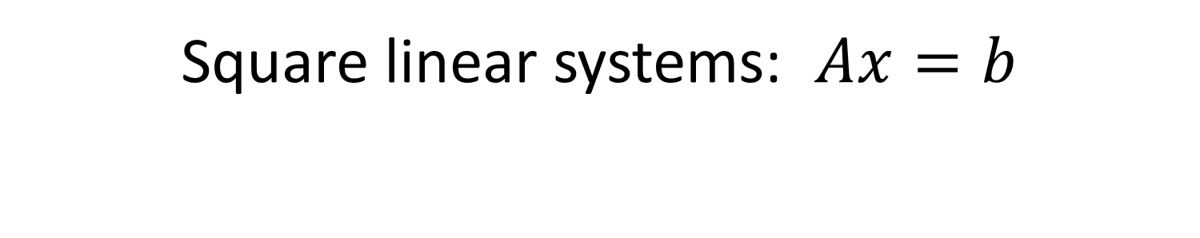
Chapter 2
Square linear systems: $Ax=b$

Slide 2
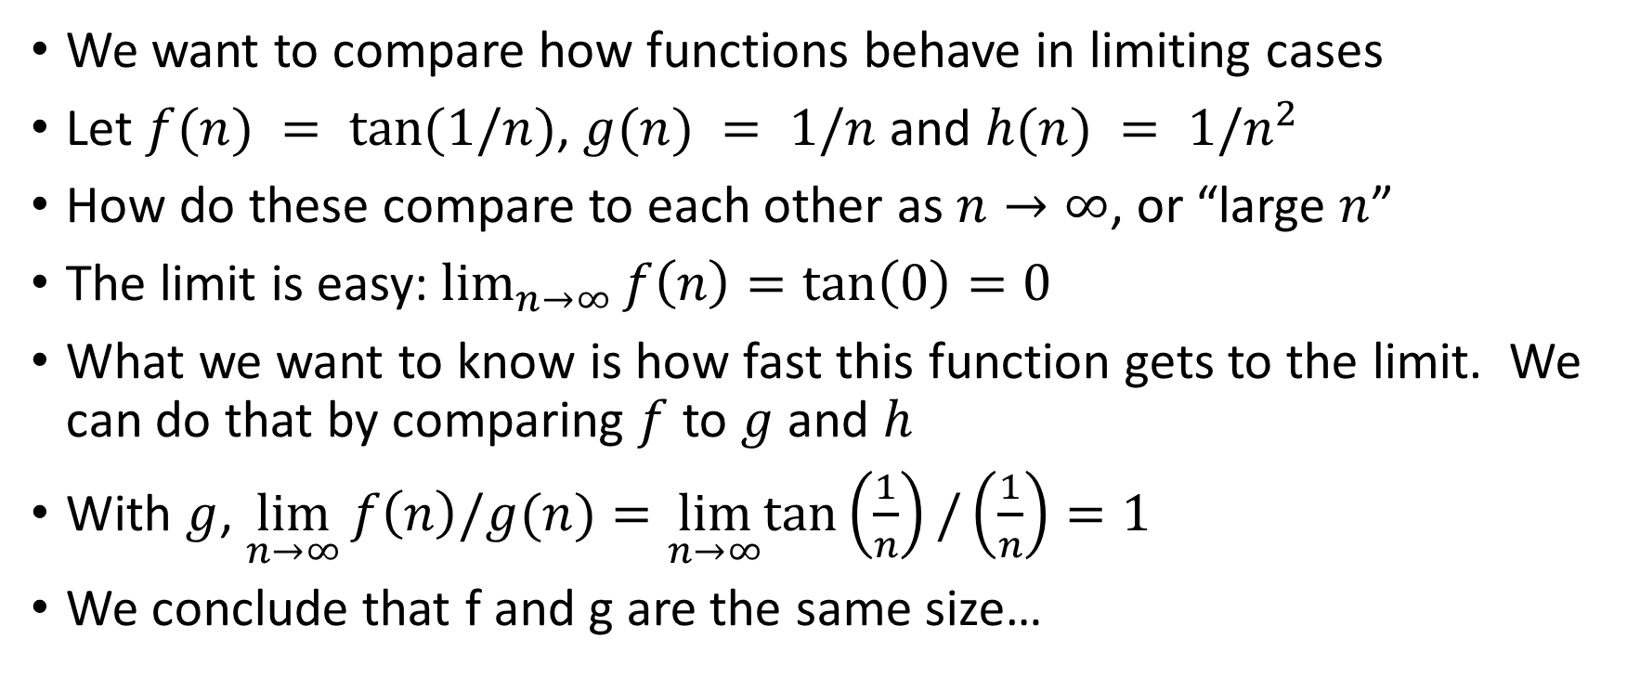
Comparing function sizes in a limit
We want to compare how functions behave in limiting cases
Let $f(n) = tan⁡(1/n)$, $g(n) = 1/n$ and $h(n) = 1/n^{2}$
How do these compare to each other as $n→∞$, or “large $n$”
The limit is easy: $\lim_{n→∞}{f\left(n\right)=\tan\left(0\right)=0}$
What we want to know is how fast this function gets to the limit. We can do that by comparing $f$ to $g$ and $h$
With $g$, $\lim_{n→∞}{f\left(n\right)/g(n)=\lim_{n→∞}tan\left(\frac{1}{n}\right)/\left(\frac{1}{n}\right)=1}$
We conclude that f and g are the same size…

Slide 3
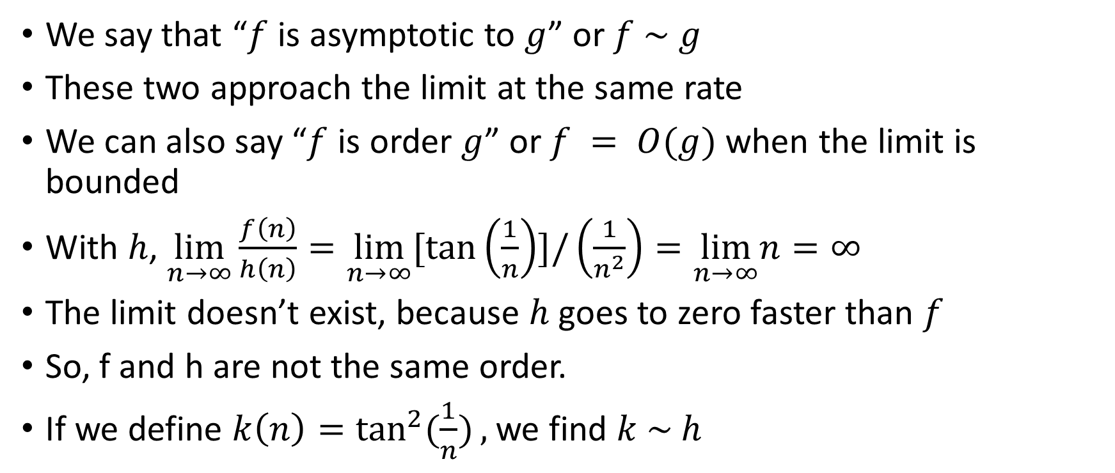
Comparing functions: Order and asymptotic
We say that “$f$ is asymptotic to $g$” or $f \sim g$
These two approach the limit at the same rate
We can also say “$f$ is order $g$” or $f = O(g)$ when the limit is bounded
With $h$, $\lim_{n→∞}{\frac{f\left(n\right)}{h\left(n\right)}=\lim_{n→∞}[tan\left(\frac{1}{n}\right)]/\left(\frac{1}{n^{2}}\right)=\lim_{n→∞}n=∞}$
The limit doesn’t exist, because $h$ goes to zero faster than $f$
So, f and h are not the same order.
If we define $k\left(n\right)=\tan^{2}{(\frac{1}{n})},$we find $k \sim h$

Slide 4
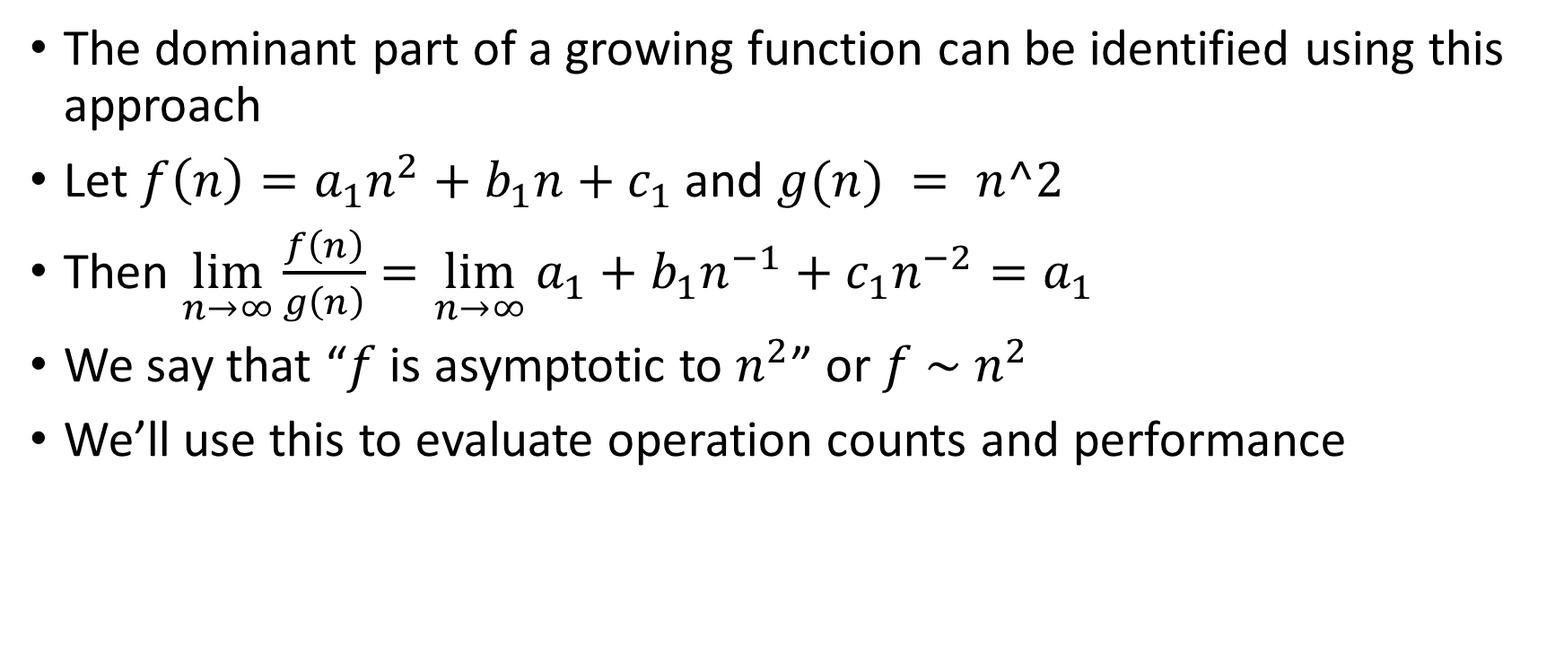
Comparing functions: Order and asymptotic
The dominant part of a growing function can be identified using this approach
Let $f\left(n\right)=a_{1}n^{2}+b_{1}n+c_{1}$ and $g(n) = n^2$
Then $\lim_{n→∞}{\frac{f\left(n\right)}{g\left(n\right)}=\lim_{n→∞}{a_{1}+b_{1}n^{−1}+c_{1}n^{−2}}=a_{1}}$
We say that “$f$ is asymptotic to $n^{2}$” or $f \sim n^{2}$
We’ll use this to evaluate operation counts and performance

Slide 5
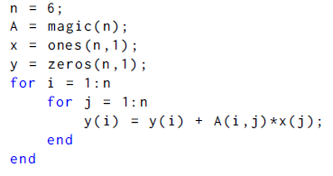

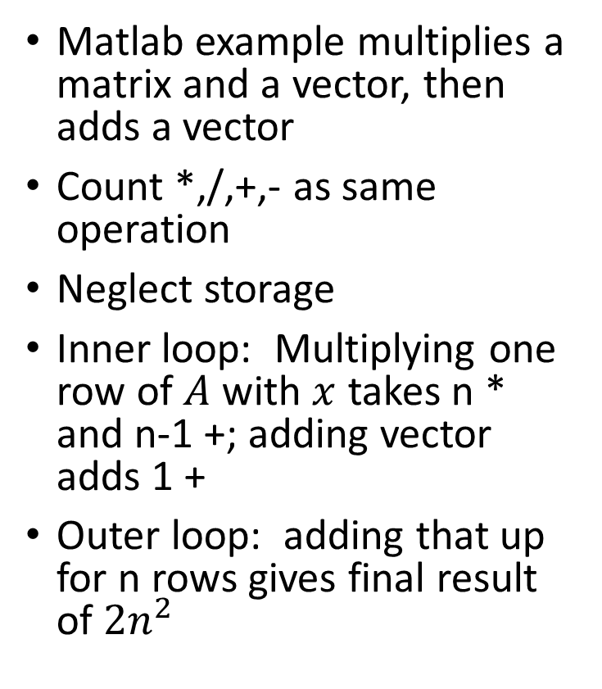
Operation Counts: Example
Matlab example multiplies a matrix and a vector, then adds a vector
Count *,/,+,- as same operation
Neglect storage
Inner loop: Multiplying one row of $A$ with $x$ takes n * and n-1 +; adding vector adds 1 +
Outer loop: adding that up for n rows gives final result of $2n^{2}$

Slide 6
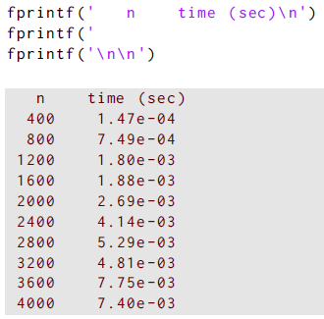
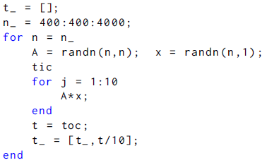
Operation Counts: Matlab
Let’s test Matlab matrix-vector multiplication
Time using stopwatch functions tic and toc
Repeat to get more reliable timing
How fast is the time growing?

Slide 7
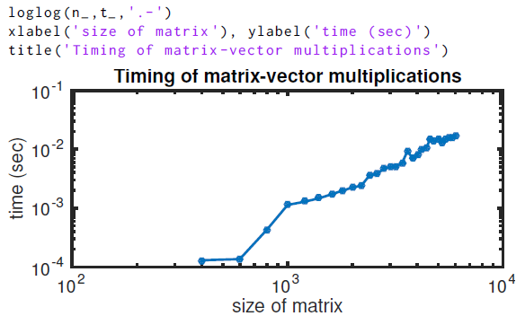
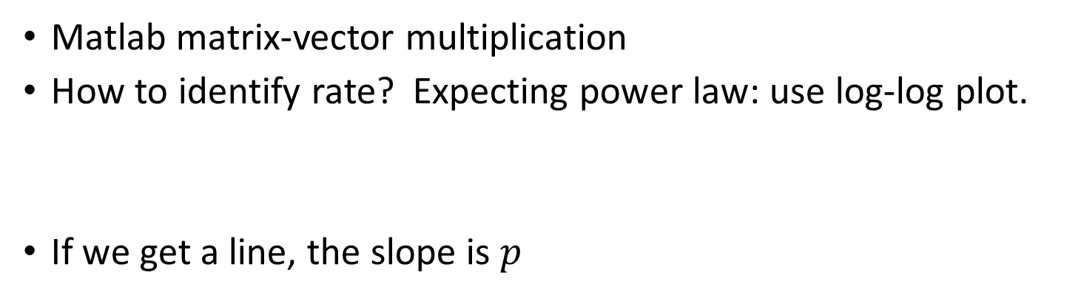
Operation Counts: Matlab
Matlab matrix-vector multiplication
How to identify rate? Expecting power law: use log-log plot.
If we get a line, the slope is $p$

Slide 8
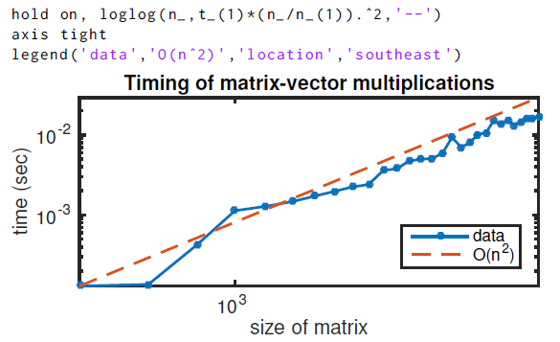
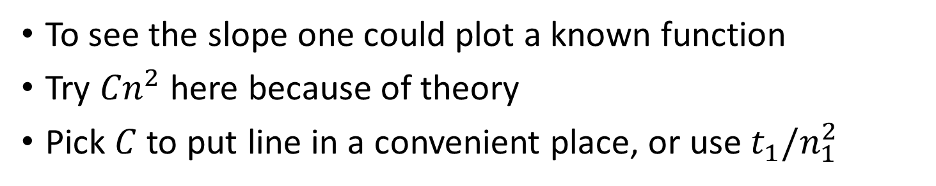
Operation Counts: Matlab
To see the slope one could plot a known function
Try ${Cn}^{2}$ here because of theory
Pick $C$ to put line in a convenient place, or use $t_{1}/n_{1}^{2}$

Slide 9
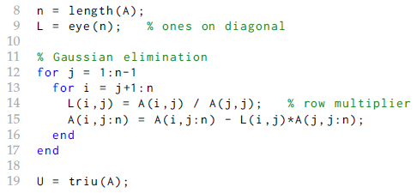
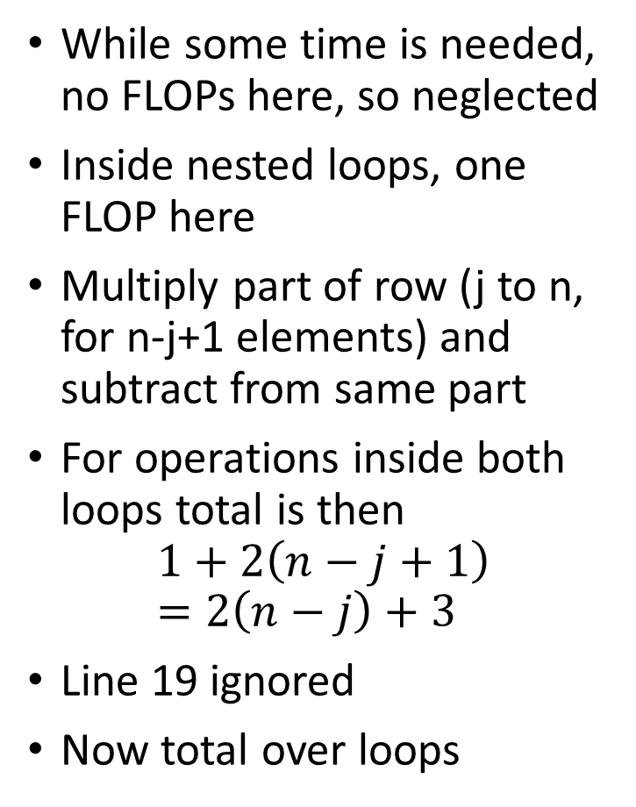
Operation Count: LU
While some time is needed, no FLOPs here, so neglected
Inside nested loops, one FLOP here
Multiply part of row (j to n, for n-j+1 elements) and subtract from same part
For operations inside both loops total is then
$$1+2\left(n−j+1\right)=2\left(n−j\right)+3$$
Line 19 ignored
Now total over loops

Slide 10

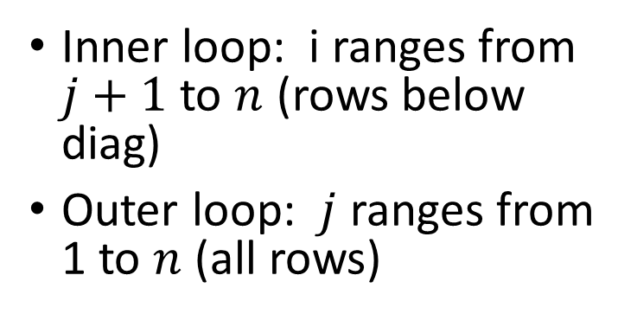
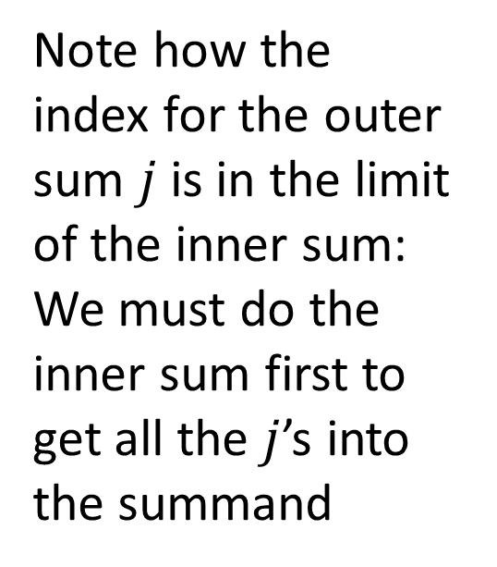
Operation Count: LU
Inner loop: i ranges from $j+1$ to $n$ (rows below diag)
Outer loop: $j$ ranges from 1 to $n$ (all rows)
Note how the index for the outer sum $j$ is in the limit of the inner sum: We must do the inner sum first to get all the $j$’s into the summand

Slide 11


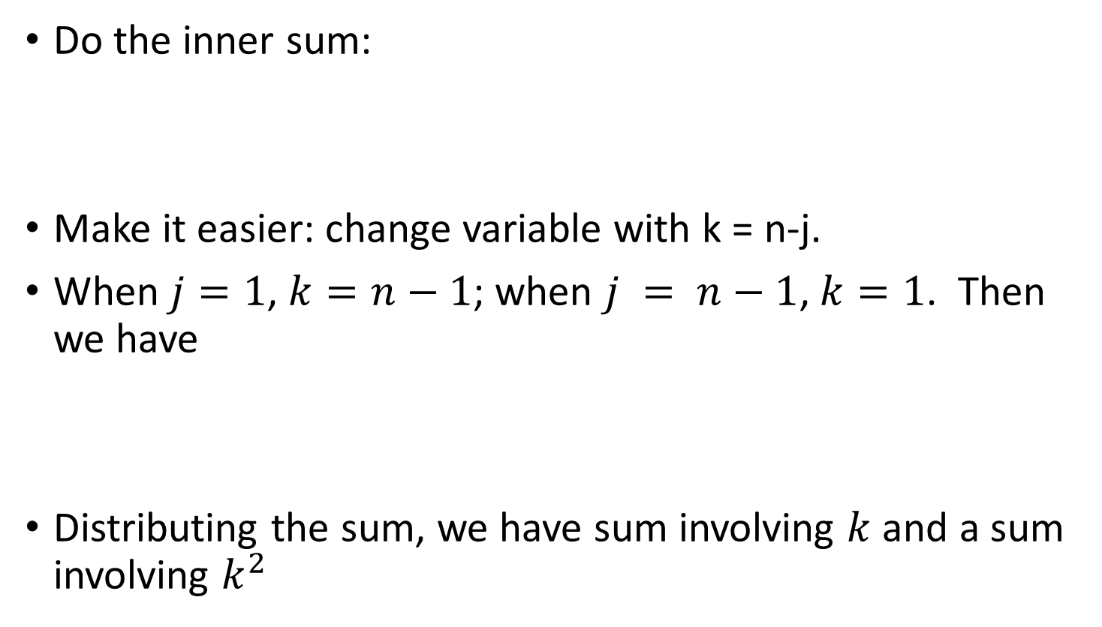
Operation Count: LU
Do the inner sum:
Make it easier: change variable with k = n-j.
When $j=1$, $k=n−1$; when $j = n−1$, $k=1$. Then we have
Distributing the sum, we have sum involving $k$ and a sum involving $k^{2}$

Slide 12
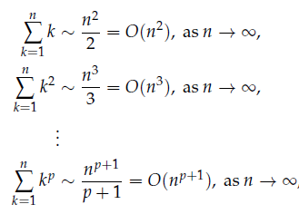
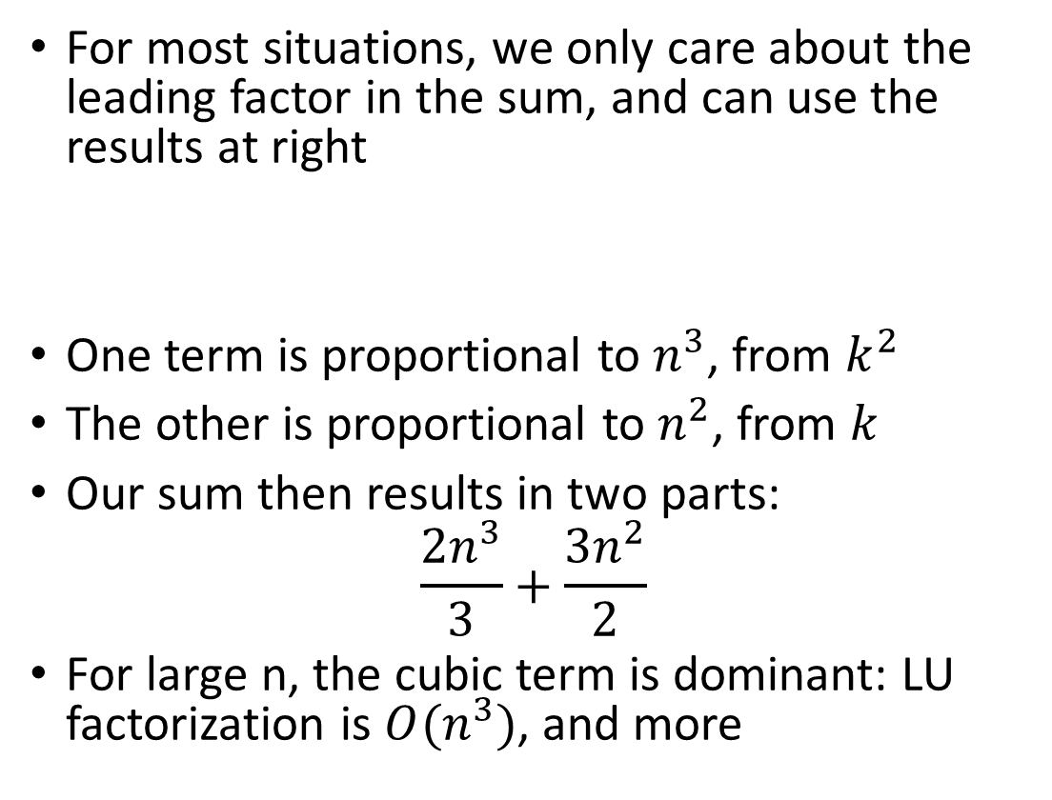
Operation Count: LU
For most situations, we only care about the leading factor in the sum, and can use the results at right
One term is proportional to $n^{3}$, from $k^{2}$
The other is proportional to $n^{2}$, from $k$
Our sum then results in two parts:
$$\frac{2n^{3}}{3}+\frac{3n^{2}}{2}$$
For large n, the cubic term is dominant: LU factorization is $O(n^{3})$, and more

Slide 13
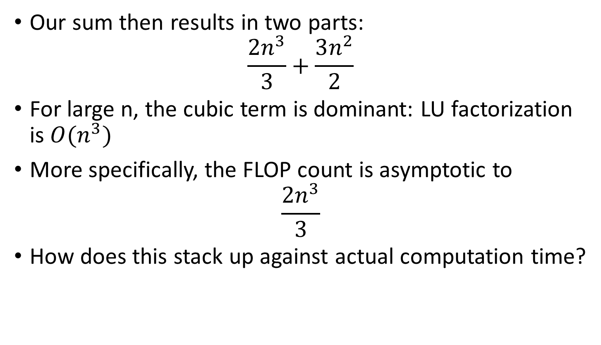
Operation Count: LU
Our sum then results in two parts:
$$\frac{2n^{3}}{3}+\frac{3n^{2}}{2}$$
For large n, the cubic term is dominant: LU factorization is $O(n^{3})$
More specifically, the FLOP count is asymptotic to
$$\frac{2n^{3}}{3}$$
How does this stack up against actual computation time?

Slide 14

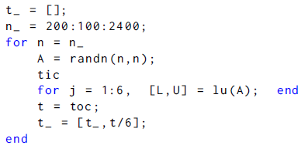
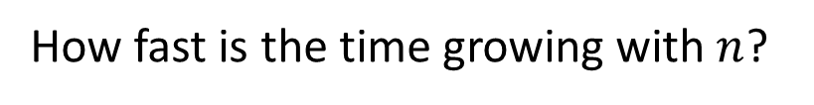
Operation Counts: LU
Let’s test with Matlab
Use functions tic and toc: wall clock time
Increase matrix size n
Repeat to get more reliable timing
How fast is the time growing with $n$?

Slide 15
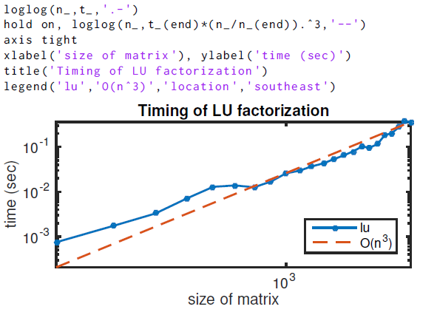
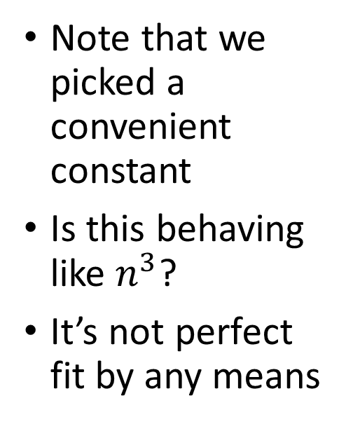
Operation Counts: Matlab
Note that we picked a convenient constant
Is this behaving like $n^{3}$?
It’s not perfect fit by any means

Slide 16
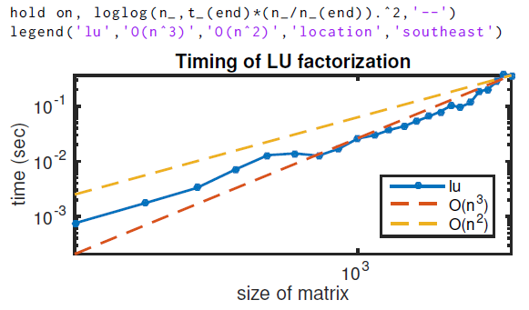
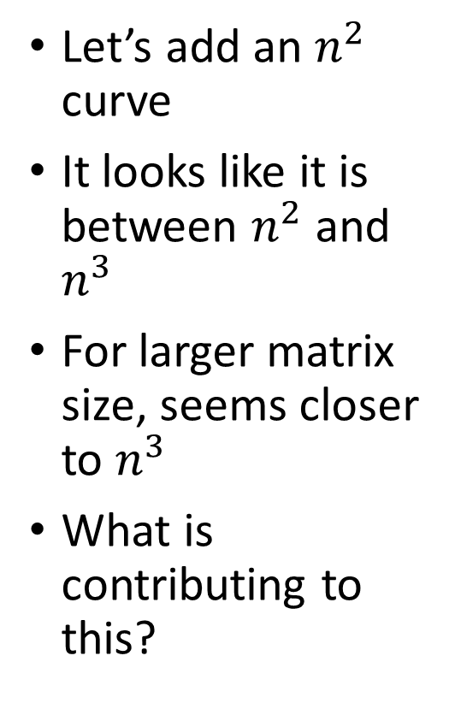
Operation Counts: Matlab
Let’s add an $n^{2}$ curve
It looks like it is between $n^{2}$ and $n^{3}$
For larger matrix size, seems closer to $n^{3}$
What is contributing to this?

Slide 17
Operation Count: LU
We assumed all that mattered was time to do one flop and that they were sequential
CPUs can have multiple cores, and can have vectorized operations
These can violate our assumptions
Parallel computation is even more different: time to send data to different CPUs can even dominate the computation
The details of the specific hardware matter
If computational time is important to your project, test it!!!!

Slide 18
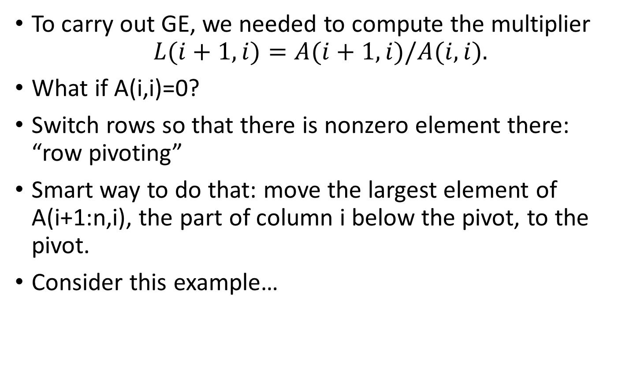
Fixing up issues with naïve GE
To carry out GE, we needed to compute the multiplier
$$L(i+1,i)=A(i+1,i)/A(i,i).$$
What if A(i,i)=0?
Switch rows so that there is nonzero element there: “row pivoting”
Smart way to do that: move the largest element of A(i+1:n,i), the part of column i below the pivot, to the pivot.
Consider this example…

Slide 19
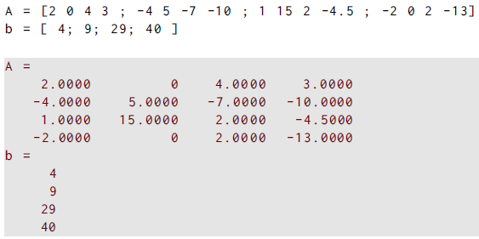
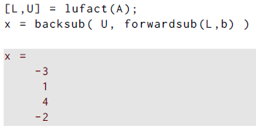
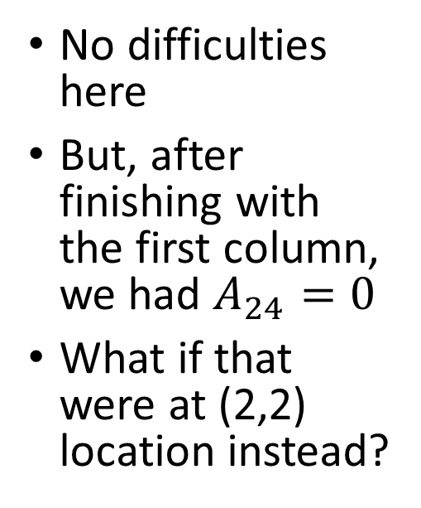
Our previous example
No difficulties here
But, after finishing with the first column, we had $A_{24}=0$
What if that were at (2,2) location instead?

Slide 20
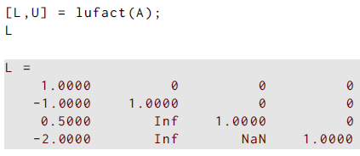

Our previous example
We can use the following to change the order of the equations with $R_2 ↔ R_4$
Theoretically, the answer does not change, and the \ gets it right
But, lufact fails!

Slide 21
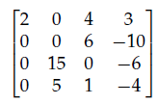

Our previous example
We can use the following to change the order of the equations with $R_2 ↔ R_4$
Theoretically, the answer does not change, and the \ gets it right
But, lufact fails!
Why? Zero pivot after first column finished

Slide 22
Fixing up issues with naïve GE
The fact that we get a zero pivot can be fixed by switching rows, IF the column below the pivot is not all zero
If the A(i:n,i)=0, then the columns 1:i are linearly dependent, and there is no unique solution
This implies that the original matrix A is singular
Theorem 2: If a pivot element and all the elements below it are zero, then the original matrix A is singular. In other words, if A is nonsingular, then Gaussian elimination with row pivoting will run to completion.
This tells us that using row pivoting is well worth implementing

Slide 23
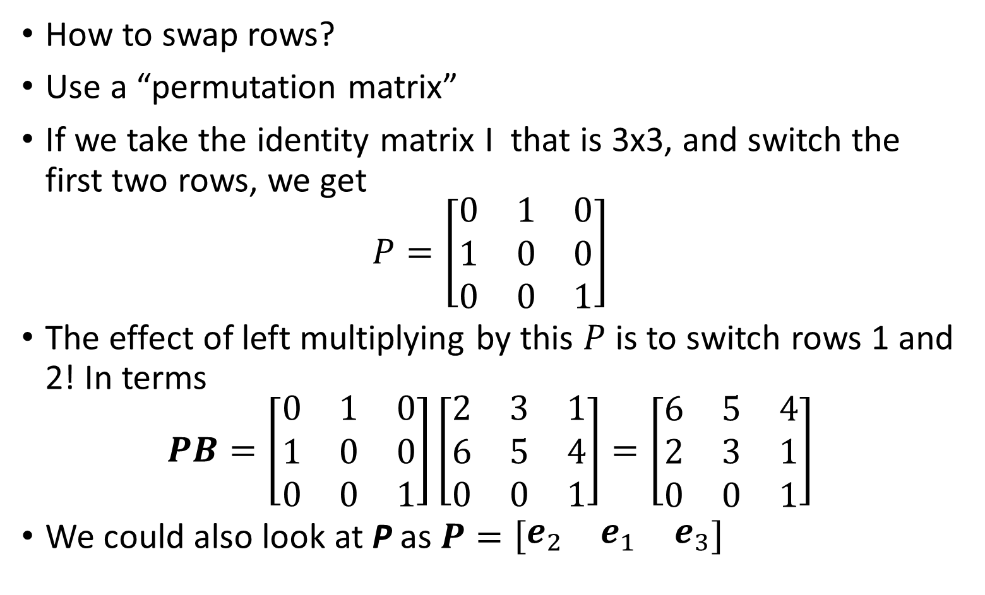
Our previous example
How to swap rows?
Use a “permutation matrix”
If we take the identity matrix I that is 3x3, and switch the first two rows, we get
$$P=\left[\begin{matrix}0 & 1 & 0 \\ 1 & 0 & 0 \\ 0 & 0 & 1\end{matrix}\right]$$
The effect of left multiplying by this $P$ is to switch rows 1 and 2! In terms
$$PB=\left[\begin{matrix}0 & 1 & 0 \\ 1 & 0 & 0 \\ 0 & 0 & 1\end{matrix}\right]\left[\begin{matrix}2 & 3 & 1 \\ 6 & 5 & 4 \\ 0 & 0 & 1\end{matrix}\right]=\left[\begin{matrix}6 & 5 & 4 \\ 2 & 3 & 1 \\ 0 & 0 & 1\end{matrix}\right]$$
We could also look at P as $P=\left[\begin{matrix}e_{2} & e_{1} & e_{3}\end{matrix}\right]$

Slide 24
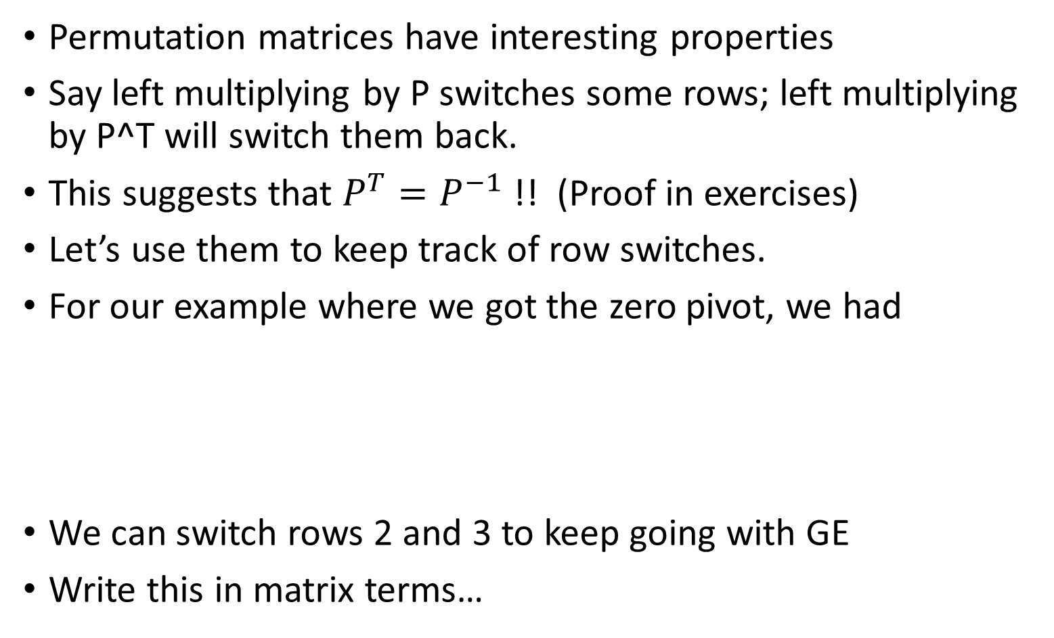
Permutations and row switches
Permutation matrices have interesting properties
Say left multiplying by P switches some rows; left multiplying by P^T will switch them back.
This suggests that $P^{T}=P^{−1}$!! (Proof in exercises)
Let’s use them to keep track of row switches.
For our example where we got the zero pivot, we had
We can switch rows 2 and 3 to keep going with GE
Write this in matrix terms…

Slide 25
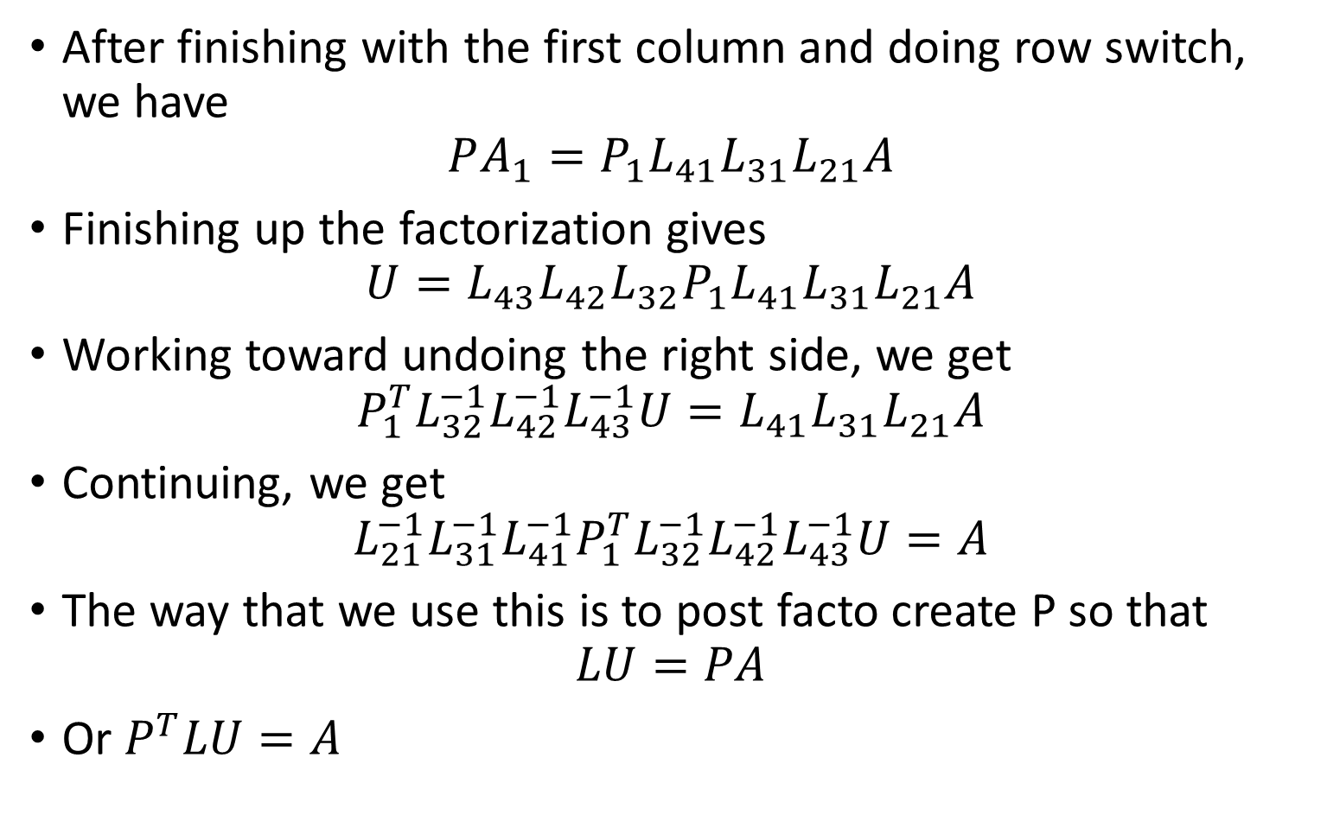
Row switches in LU
After finishing with the first column and doing row switch, we have
$$PA_{1}=P_{1}L_{41}L_{31}L_{21}A$$
Finishing up the factorization gives
$$U=L_{43}L_{42}L_{32}P_{1}L_{41}L_{31}L_{21}A$$
Working toward undoing the right side, we get
$$P_{1}^{T}L_{32}^{−1}L_{42}^{−1}L_{43}^{−1}U=L_{41}L_{31}L_{21}A$$
Continuing, we get
$$L_{21}^{−1}L_{31}^{−1}L_{41}^{−1}P_{1}^{T}L_{32}^{−1}L_{42}^{−1}L_{43}^{−1}U=A$$
The way that we use this is to post facto create P so that
$$LU=PA$$
Or $P^{T}LU=A$

Slide 26
Row switches in LU: MATLAB
We will use MATLAB’s builtin function lu
The syntax is [L,U,P] = lu(A)
To use this, we first view the system at Pax=Pb
Then use L and U as before, because row switching won’t be needed now
Thus, PA = LU and let Ux = z.
Then, Lz = Pb
Solving the system can then be done by:
using forwardsub on Lz=Pb to get z,
then using backsub on Ux=z to get x

Slide 27
Partial pivoting in MATLAB
Solving systems using lu in MATLAB and our functions is then as follows:
Find L, U and P from [L,U,P] = lu(A);
Solve Lz=Pb using z = forwardsub(L,P*b);
Solve Ux=z using x = backsub(U,z).
Using MATLAB’s lu and \, one does:
Find L, U and P from [L,U,P] = lu(A);
Solve Lz=Pb using z = L\(P*b);
Solve Ux=z using x = U\z.

Slide 28
Example using LU
Swapped row system at left

Slide 29
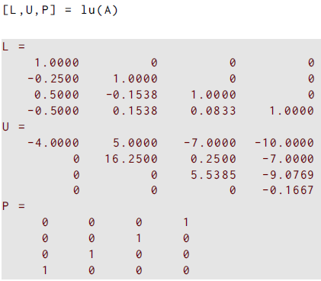
Example using LU
Swapped row system at left
lu gives L,U,P

Slide 30
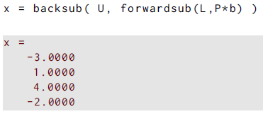
Example using LU
Swapped row system at left
lu gives L,U,P
In one line, forwardsub, then backsub

Slide 31
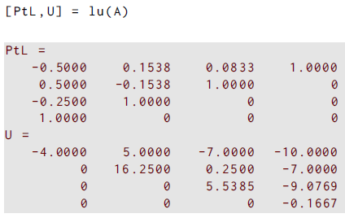
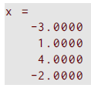
Example using PtLU
Use only two output arguments
lu gives PtL and U
The backslash is better than forwardsub and can use the row-switched L (i.e, PtL)
Using the backslash can solve the two system sequence in one line

Slide 32

Example using only MATLAB’s \
Using \ solves the system directly
Any row switching is transparent
Compares well with previous solution

Slide 33


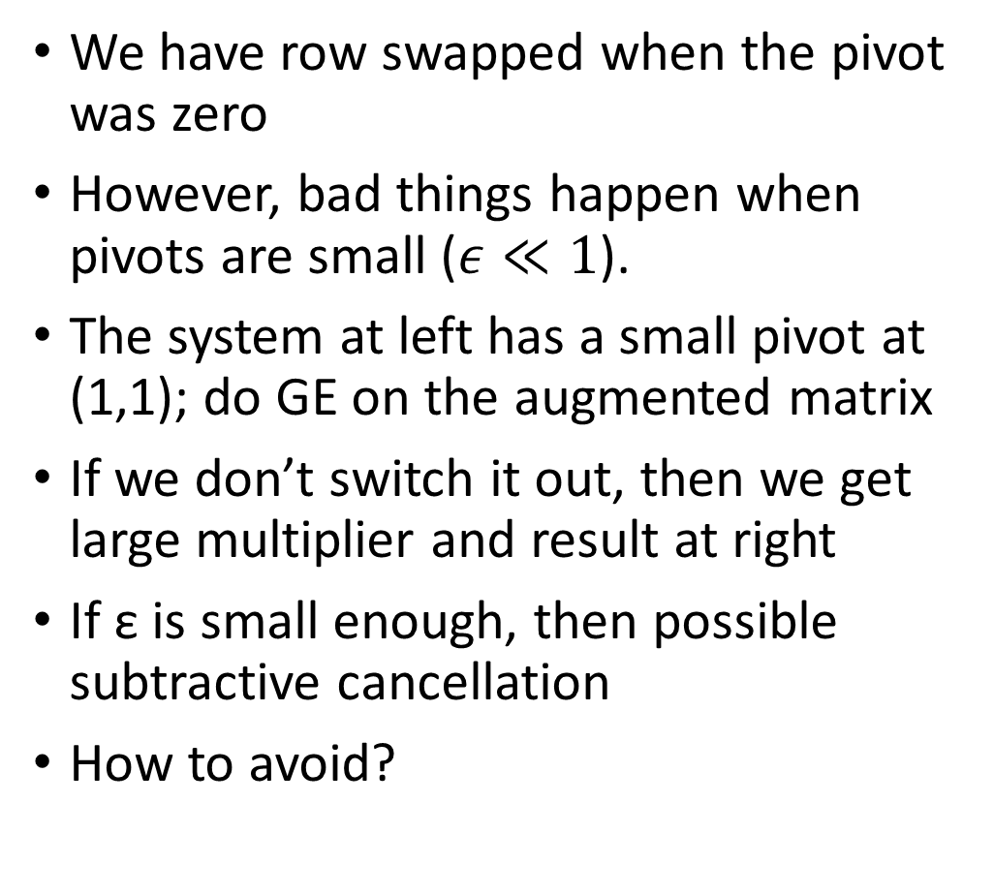
What about small pivots
We have row swapped when the pivot was zero
However, bad things happen when pivots are small ($ε≪1$).
The system at left has a small pivot at (1,1); do GE on the augmented matrix
If we don’t switch it out, then we get large multiplier and result at right
If ε is small enough, then possible subtractive cancellation
How to avoid?

Slide 34

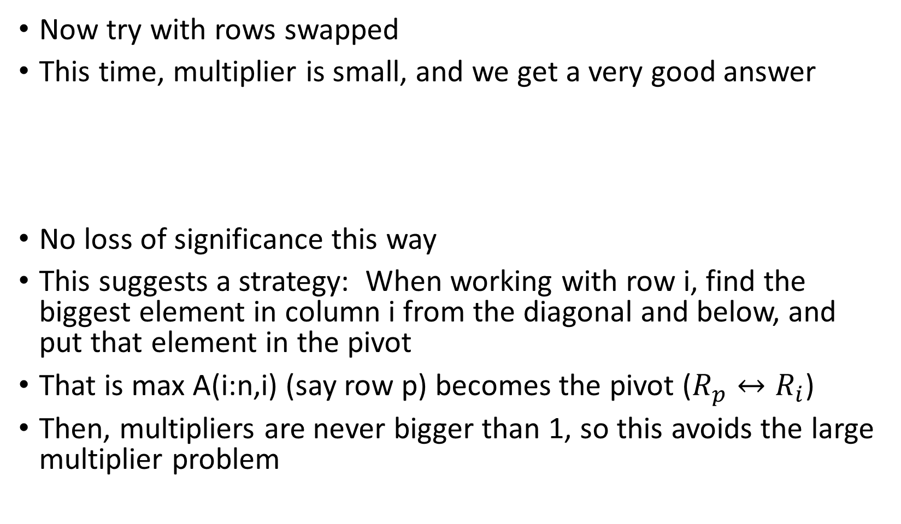
What about small pivots
Now try with rows swapped
This time, multiplier is small, and we get a very good answer
No loss of significance this way
This suggests a strategy: When working with row i, find the biggest element in column i from the diagonal and below, and put that element in the pivot
That is max A(i:n,i) (say row p) becomes the pivot ($R_{p}↔R_{i}$)
Then, multipliers are never bigger than 1, so this avoids the large multiplier problem

Slide 35
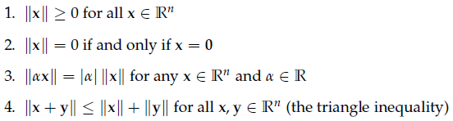
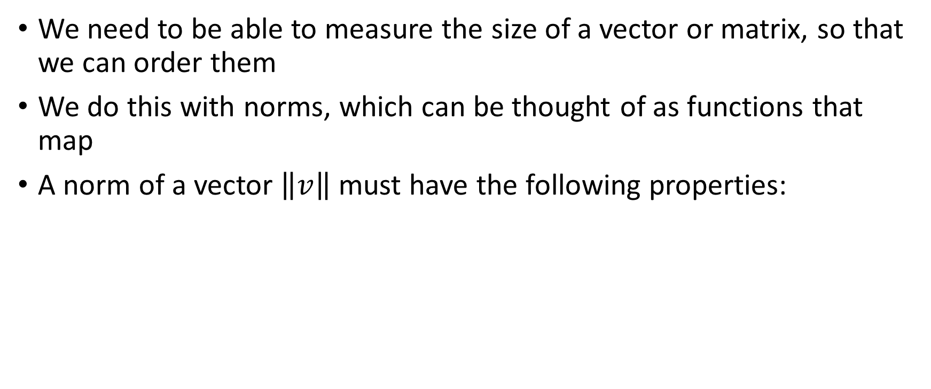
Vector Norms
We need to be able to measure the size of a vector or matrix, so that we can order them
We do this with norms, which can be thought of as functions that map
A norm of a vector $\left\|v\right\|$ must have the following properties:

Slide 36
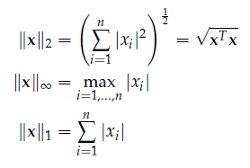

Norms of vectors
The general vector norm of interest is the p-norm:
$${{\left\|v\right\|}_{p}=\left[\sum_{i=0}^{n}{{\left|v_{i}\right|}^{p}}\right]}^{1/p}$$
We are most interested in only three values of p: 1,2, or ∞

Slide 37
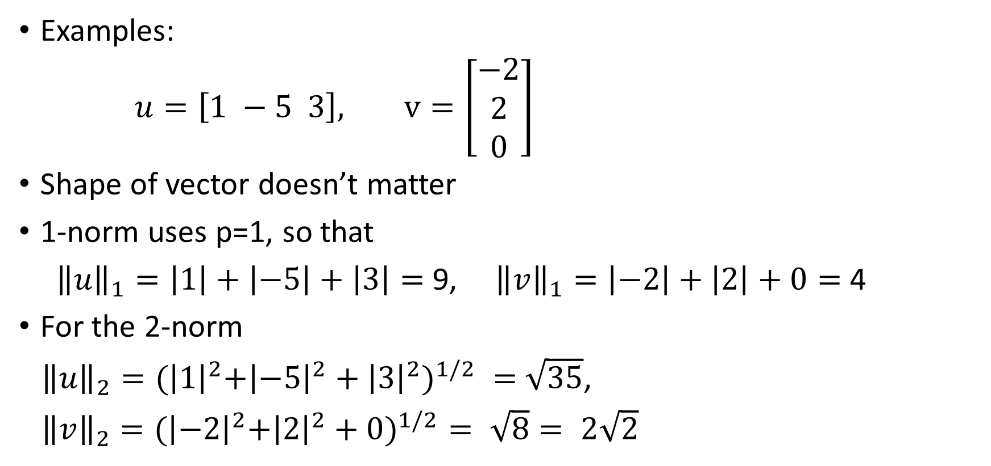
Norms of vectors
Examples:
$u=\left[1 −5 3\right],$ $v=\left[\begin{matrix}−2 \\ 2 \\ 0\end{matrix}\right]$
Shape of vector doesn’t matter
1-norm uses p=1, so that
${\left\|u\right\|}_{1}=\left|1\right|+\left|−5\right|+\left|3\right|=$ 9, ${\left\|v\right\|}_{1}=\left|−2\right|+\left|2\right|+0=$ 4
For the 2-norm
${\left\|u\right\|}_{2}={(\left|1\right|}^{2}+{\left|−5\right|}^{2}+{{\left|3\right|}^{2})}^{1/2} =$ $\sqrt{35}$,
${\left\|v\right\|}_{2}={(\left|−2\right|}^{2}+{\left|2\right|}^{2}+{0)}^{1/2}= \sqrt{8}= 2\sqrt{2}$

Slide 38

Norms of vectors
Examples:
$u=\left[1 −5 3\right],$ $v=\left[\begin{matrix}−2 \\ 2 \\ 0\end{matrix}\right]$
∞-norm now:
${\left\|u\right\|}_{∞}=\max{(\left|1\right|,\left|−5\right|,\left|3\right|)}=$ 5
Multiply by a scalar?
Always ≥ 0?
Only 0 if 0 vector?

Slide 39


Norms of vectors
What do unit vectors look like?
Given $x=[x_{1} x_{2}]$, we can create the unit vector or direction $x/{\left\|x\right\|}_{ }$
For $x=[x_{1} x_{2}]$and ${\left\|x\right\|}_{2}$, unit vectors have ${\left\|x\right\|}_{2}={\left({|x}_{1}{\left.​\right|}^{2}{+|x}_{2}{\left.​\right|}^{2}\right)}^{1/2}=1$
In the ($x_{1},x_{2}$)-plane, the set of all unit vector is a circle
What about ∞-norm?
${\left\|x\right\|}_{∞}={\max{({|x}_{1}{\left.​\right|}^{ }{,|x}_{2}{\left.​\right|}^{ })}}^{ }=1$; what is it?

Slide 40

Norms of matrices
Measuring the “size” of a matrix should be associated with a vector norm: Induced matrix norms
For $x=[x_{1} x_{2}]$and ${\left\|x\right\|}_{2}$, the induced matrix norm is${\left\|A\right\|}_{2}=\max_{{\left\|x\right\|}_{2}=1}{({\left\|Ax\right\|}_{2})}=\max_{{\left\|x\right\|}_{2}≠0}{({\left\|Ax\right\|}_{2}/{\left\|x\right\|}_{2})}$
When we multiply x by a matrix, then it is stretched and pointed in a different direction, generally
The magnitude of the biggest stretching is the norm of A

Slide 41

Norms of matrices
We can multiply the set of unit vectors by A and see what the distortion does to all of those unit vectors
The magnitude of the biggest stretching is the norm of A

Slide 42

Norms of matrices
The induced norms for the other matrices are a bit easier to compute
The ∞-norm is the maximum row sum of the matrix A
The 1-norm is the maximum column sum of A
Mnemonic: think of the “direction” of 1 or ∞
Example: $A=\left[\begin{matrix}1 & 3 \\ −5 & 8\end{matrix}\right]$
${\left\|A\right\|}_{1}=\max{(1+5,3+8)}=11$
${\left\|A\right\|}_{∞}=\max{(1+3,5+8)}=13$

Slide 43

Norms of matrices
We need some properties of matrix norms for future use.
One can prove the following for any of the norms we have used.

Slide 44

Stability analysis of solving systems
We want to solve $Ax=b$
We want to analyze how robust our answers are to perturbations of $A$ and b
To measure what happens to the sizes of vectors and matrices, use norms
We know that $\left|\left|b\right|\right|=||Ax||≤||A||$ $||x||$
We also know that $x=A^{−1}b$, now take norms
$||x||=||A^{−1}b||≤\left|\left|A^{−1}\right|\right|||b||$
If we change $b$ to $b+d$, then the solution changes somewhat to $x+h$, say, such that $A\left(x+h\right)=b+d$
But, using the original equation $Ax=b$, the first term on each side cancels

Slide 45


Stability analysis of solving systems
We then have $Ah=d$
Then $h=A^{−1}d$, now take norms
$||h||=||A^{−1}d||≤\left|\left|A^{−1}\right|\right|||d||$
Let’s now look at the relative change in the solution $\left|\left|h\right|\right|/||x||$ compared to the relative change in the right hand side $\left|\left|d\right|\right|/||b||$
Taking the ratio of those two,
The last quantity is
the condition number
$κ\left(A\right)=||A^{−1}||||A^{ }||$

Slide 46

Stability analysis of solving systems
The condition number $κ\left(A\right)=||A^{−1}||||A^{ }||$ thus tells us the worst case magnification of the relative change in the answer
compared to
the relative change in the right hand side
The condition number depends on the matrix A and the norm, and it measures the sensitivity of its solutions to perturbations

Slide 47


Stability analysis of solving systems
What if we perturb A and solve $Ax=b$?
If we change $A$ to $A+E$, then the solution changes somewhat to $x+h$, say, such that $(A+E)\left(x+h\right)=b$
Expand again to get $Ax+Ex+Ah+Eh=b$
Then use $Ax=b$, and neglect $Eh$ because it is the product of two small terms; then one has $Ex+Ah=0$
Solve for $h$ and use norms:
Now compute relative changes again…

Slide 48


Stability analysis of solving systems
The condition number $κ\left(A\right)=||A^{−1}||||A^{ }||$ thus tells us the worst case magnification of the relative change in the answer
compared to
the relative change in the matrix A
The condition number measures the sensitivity of its solutions to perturbations in the matrix as well

Slide 49


Condition number
In summary, the worst case changes in the answer from perturbations to the coefficients is given by the condition number:
Note that the best we can get is a condition number of unity:

Slide 50



Condition number: example
The $n×n$ Hilbert matrix has elements
$$H_{ij} = 1/(i+j−1)$$
It’s a builtin function in MATLAB:
It is not singular, but conditioning?

Slide 51
Condition number: example
Explore the Hilbert matrix for solving sytems
Increase n gets even worse conditioning fast.
The “gallery” has a collection of commonly used matrices in numerical methods and analysis.
Try “help gallery” at prompt or search for gallery in help browser
You can find other ill-conditioned, non-singular matrices there: e.g., dorr,

Slide 52




Residuals and ill-conditioned systems
What happens to the residual $r=b−Ax$?
For the computed solution (tilde) we have
Manipulate into the useful form
Then use solve for change in solution and use norms:
Now compute relative changes again:
We can expect small residual, but…
the change in the answer may not be small for ill-conditioned systems!!!
Commercial FEM, e.g., tells you residuals: use with care!!!

Slide 53

Special matrices
We can take advantage of the structure of some kinds of matrices to create faster algorithms or get additional information.
Possibilities include:
Triangular matrices: Been there, reduces solves for $n$ unknowns from $O(n^{3})$ to $O(n^{2})$
Banded matrices: only certain diagonals have non-zero elements
Sparse matrices: only a (preferably small) minority of elements are nonzero
Symmetric matrices
Symmetric positive definite matrices

Slide 54

Banded matrices
A tridiagonal matrix has three nonzero diagonals: e.g.,
A = gallery('tridiag',c,d,e)
This matrix would have vectors c in the first subdiagonal, d on the main diagonal, and e on the first superdiagonal
The bandwidth is three. How to compute?
Upper bandwidth is $p$, with $A_{ij}=0$ if $j−i>p$
Lower bandwidth is $q$, with $A_{ij}=0$ if $i−j>q$
Total bandwidth is $p+q−1$
For this example, we’d get 3, with $p=2$ and $q=2$

Slide 55


Banded matrices
Consider
Upper bandwidth is $p=1$, lower bandwidth is $q=3$
Total bandwidth is $p+q+1=5$

Slide 56

Banded matrices
We can visualize nonzero elements with sparsity plot from spy(triu(tril(rand(7),1,-3)
Dots are shown where the nonzero elements were
The total number of nonzeros is at the bottom
Handy to see where nonzeros are in large matrices

Slide 57


Banded matrices
How do we get diagonals?
How can we build banded matrices
What happens with LU factorization?
Start with example at right
We can extract one diagonal at a time with the diag command

Slide 58

Banded matrices
How do we get diagonals?
How can we build banded matrices?
What happens with LU factorization?
Start with example at right
We can extract one diagonal at a time with the diag command
We can also create the matrix with the diag command:

Slide 59


Banded matrices
What happens with LU factorization?
Modify A with extra diag
Do LU factorization without partial pivoting
The banded structure is preserved:

Slide 60

Banded matrices
What happens with LU factorization?
Modify A with extra diag
Now do LU factorization with partial pivoting
The banded structure is not preserved:
We can improve the computing time by telling matlab that the matrices may be sparse (mostly zeros)

Slide 61



Sparse matrices
Consider tridiagonal matrices
A = gallery('tridiag',n)
This creates a $n×n$ tridiagonal matrix with 2 on the main diagonal and -1 on the sub- and super-diagonals
But, only the non-zeros are stored (let n=10 and try it!) Thus, only 28 numbers are stored for this element that would have 100 elements: 28%
If $n=100$, then nz=298, out of ${10}^{4}$ possible elements: 2.98% nonzero
In this case, $3n−2$ elements nonzero out of $n^{2}$ possible; more sparse an $n$ increases

Slide 62


Sparse matrices
Computations can be sped up significantly if we only work with the nonzeros (need to code it)
If A is sparse, full(A) will make it a full matrix

Slide 63


Sparse matrices
Consider tridiagonal matrices
A = gallery(‘wathen',n,n)
This creates a large sparse matrix; if $n=20$, the matrix is $1281×1281$ with
But, things can go wrong: LU factorization leads to fill-in
In this example, about 1.17% nonzeros in A, but look how many nonzeros after LU…

Slide 64



Sparse matrices
The commands:
Each factor L (left) and U (right) has about 6.6e4 nonzeros now! (10x more nonzeros)

Slide 65

Symmetric matrices
If $A^{T} = A$, then A is symmetric
We can modify the LU factorization:
$$A=LU=LIU=LDD^{−1}U$$
$D$ is diagonal, with the elements that would have been in U from standard factorization
Now it turns out that $D^{−1}U=L^{T}$
Then $A=LDL^{T}$

Slide 66

Symmetric positive definite matrices
If $A^{T} = A$, and
if $x^{T}Ax≥0$ for all $x∈R^{n}$ and $x ≠0$,
Then $A$ is positive definite
We can modify the LU factorization again to the Cholesky factorization:
$$A=R^{T}R, R=D^{1/2}L^{T}$$
$R$has all positive entries on the diagonal
The MATLAB function chol will compute the Cholesky factorization

Slide 67


Symmetric positive definite matrices
Start with A=magic(5);

Slide 68

Symmetric positive definite matrices
If $A^{T} = A$, and
if $x^{T}Ax≥0$ for all $x∈R^{n}$ and $x ≠0$,
Then $A$ is positive definite
We can modify the LU factorization again to the Cholesky factorization:
$$A=R^{T}R, R=D^{1/2}L^{T}$$
$R$has all positive entries on the diagonal
The MATLAB function chol will compute the Cholesky factorization

